Slide 1

LOG ANALYZE

Slide 2
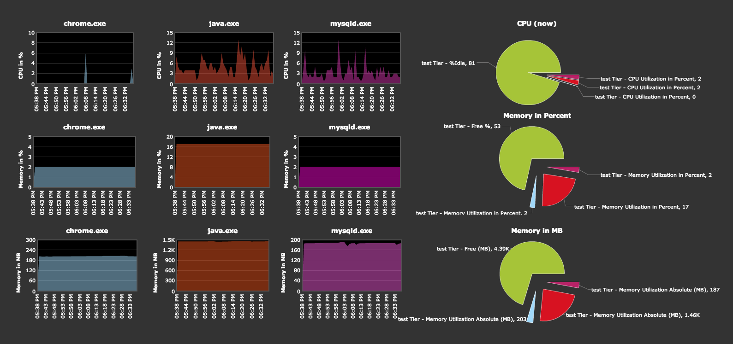
Benefits
Production monitoring and debugging
Resource usage
Performance analysis

Slide 3
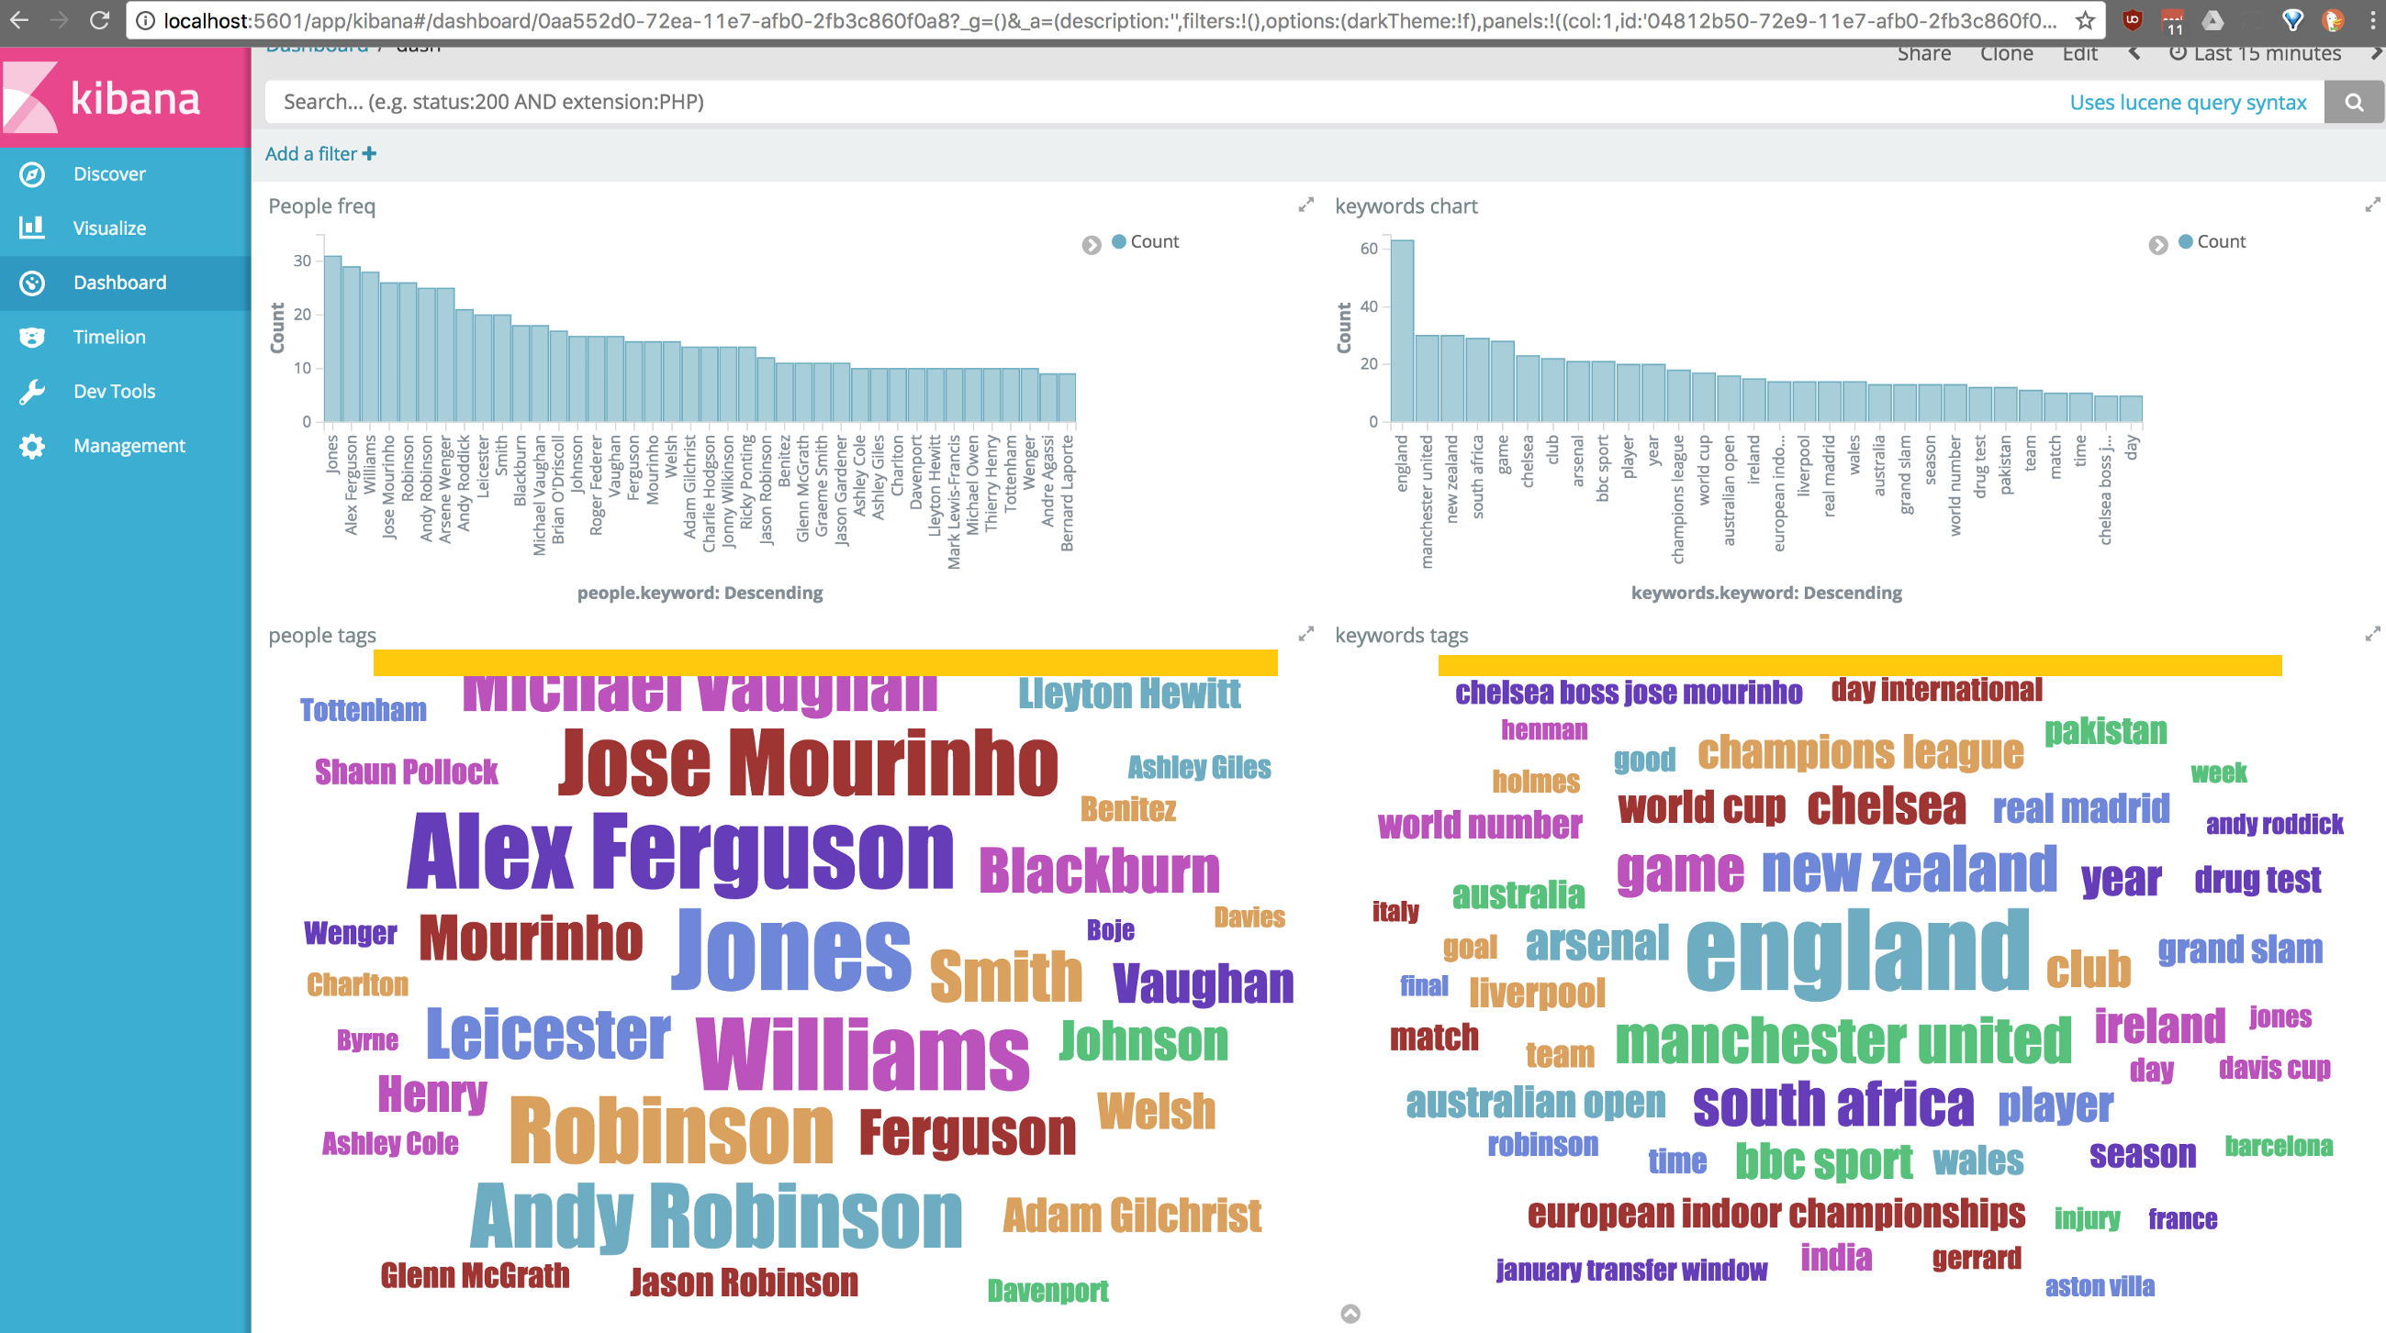
Benefits
Tracking client requests
Identifying key trends

Slide 4
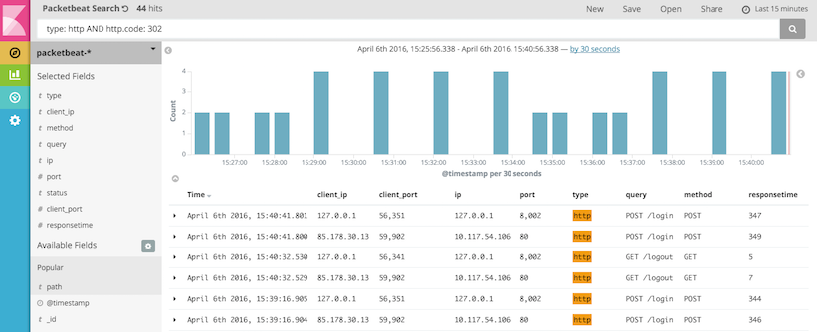
Benefits
Easy to read log
Easy to find problems

Slide 5

Benefits
Understand our system and the way user interact with it.

Slide 6
Workflow

Slide 7
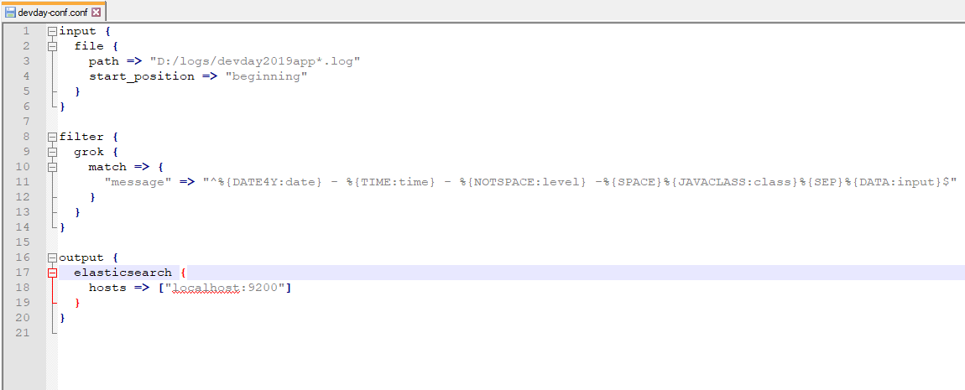
Logstash
Parse log line into readable format

Slide 8
Elasticsearch
Store logs
Act as a datasource for Kibana

Slide 9
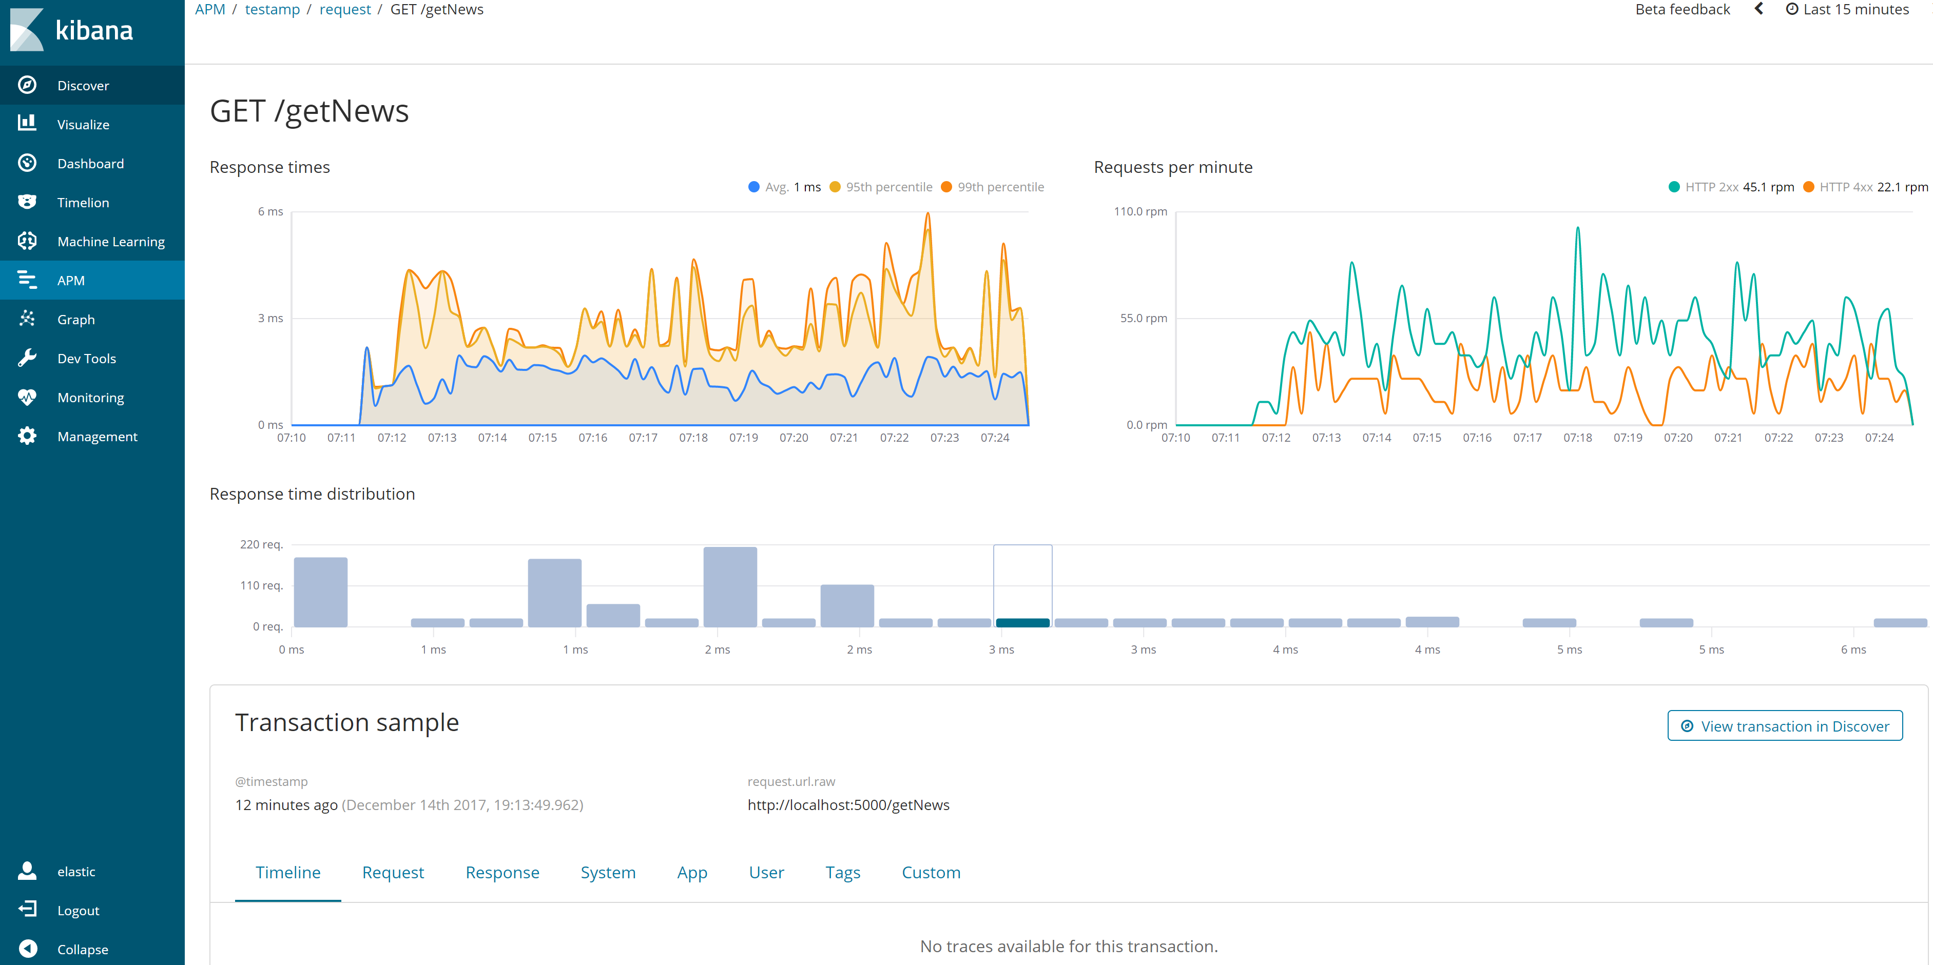
Kibana
Display data using chart

Slide 10
Getting started
1. Know your log structure
2. Parse log by Logstash
3. Visualize by Kibana

